Slide 1
Agents
By marcelcastrobr
Notes:
Hvordan bruker Kongsberg Maritime KI?

Slide 2
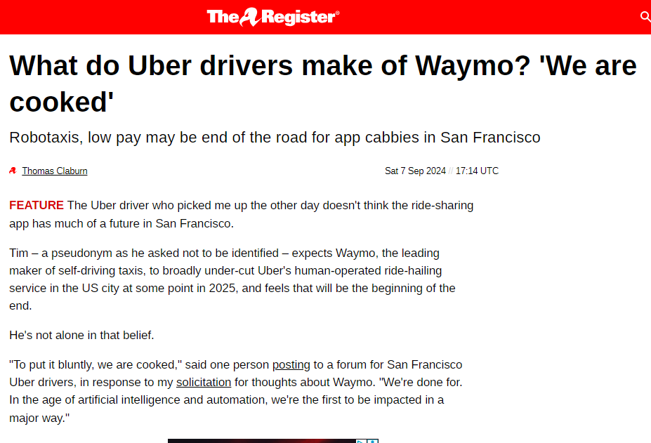
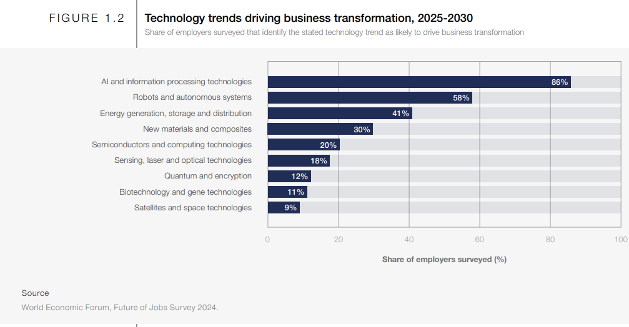
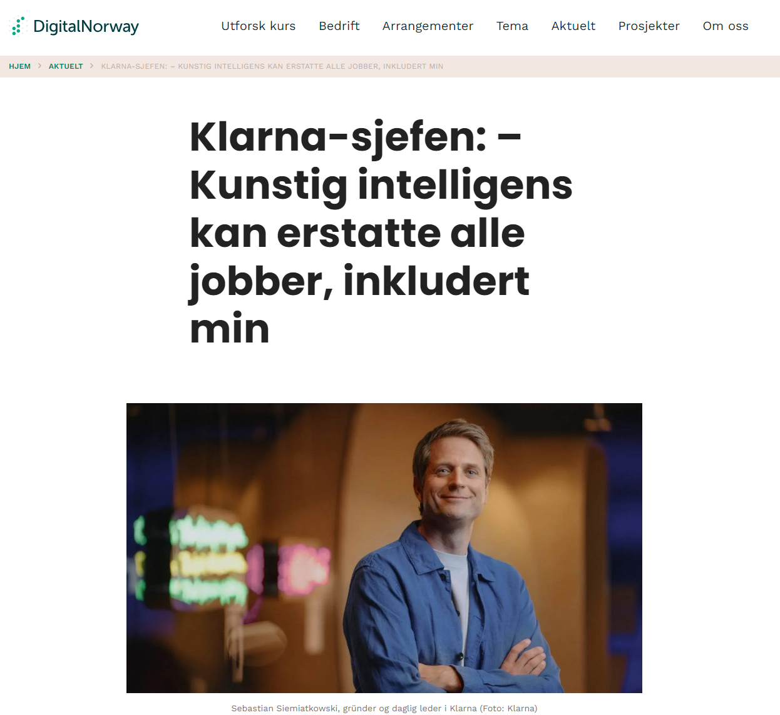
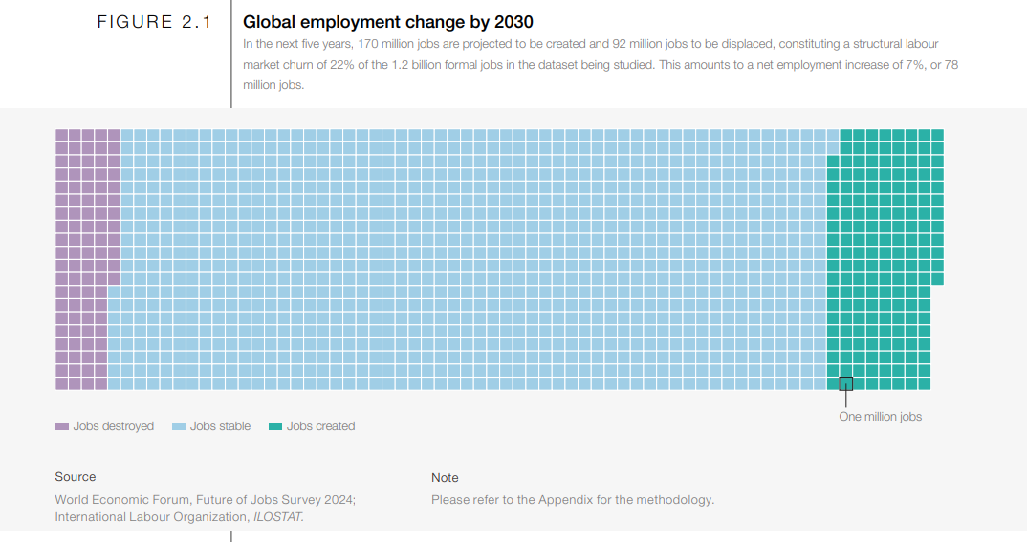
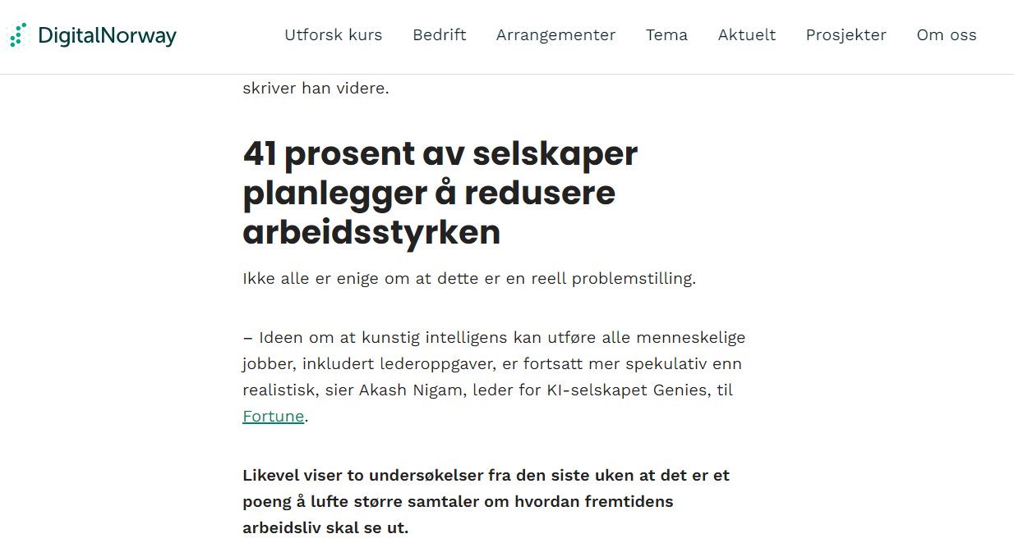
Motivation
Notes:
X: Sebastian Siemiatkowski on X: "I realize my statements on “AI can already do all our jobs” caused quite a stirr. So let me explain and expand what I mean. In my opinion the major breakthrough of AI is a computer with “reasoning” capabilities. This has basically been achieved already. Not if you present AI" / X
What do Uber drivers make of Waymo? 'We are cooked' • The Register
WEF_Future_of_Jobs_Report_2025.pdf

Slide 3
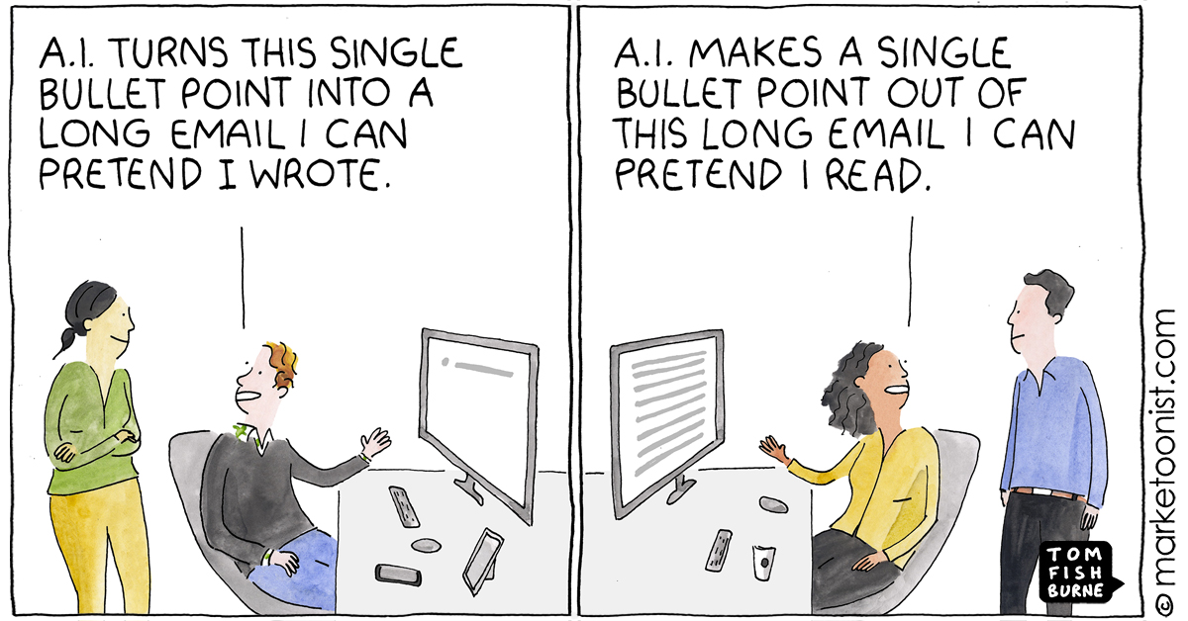

Slide 4
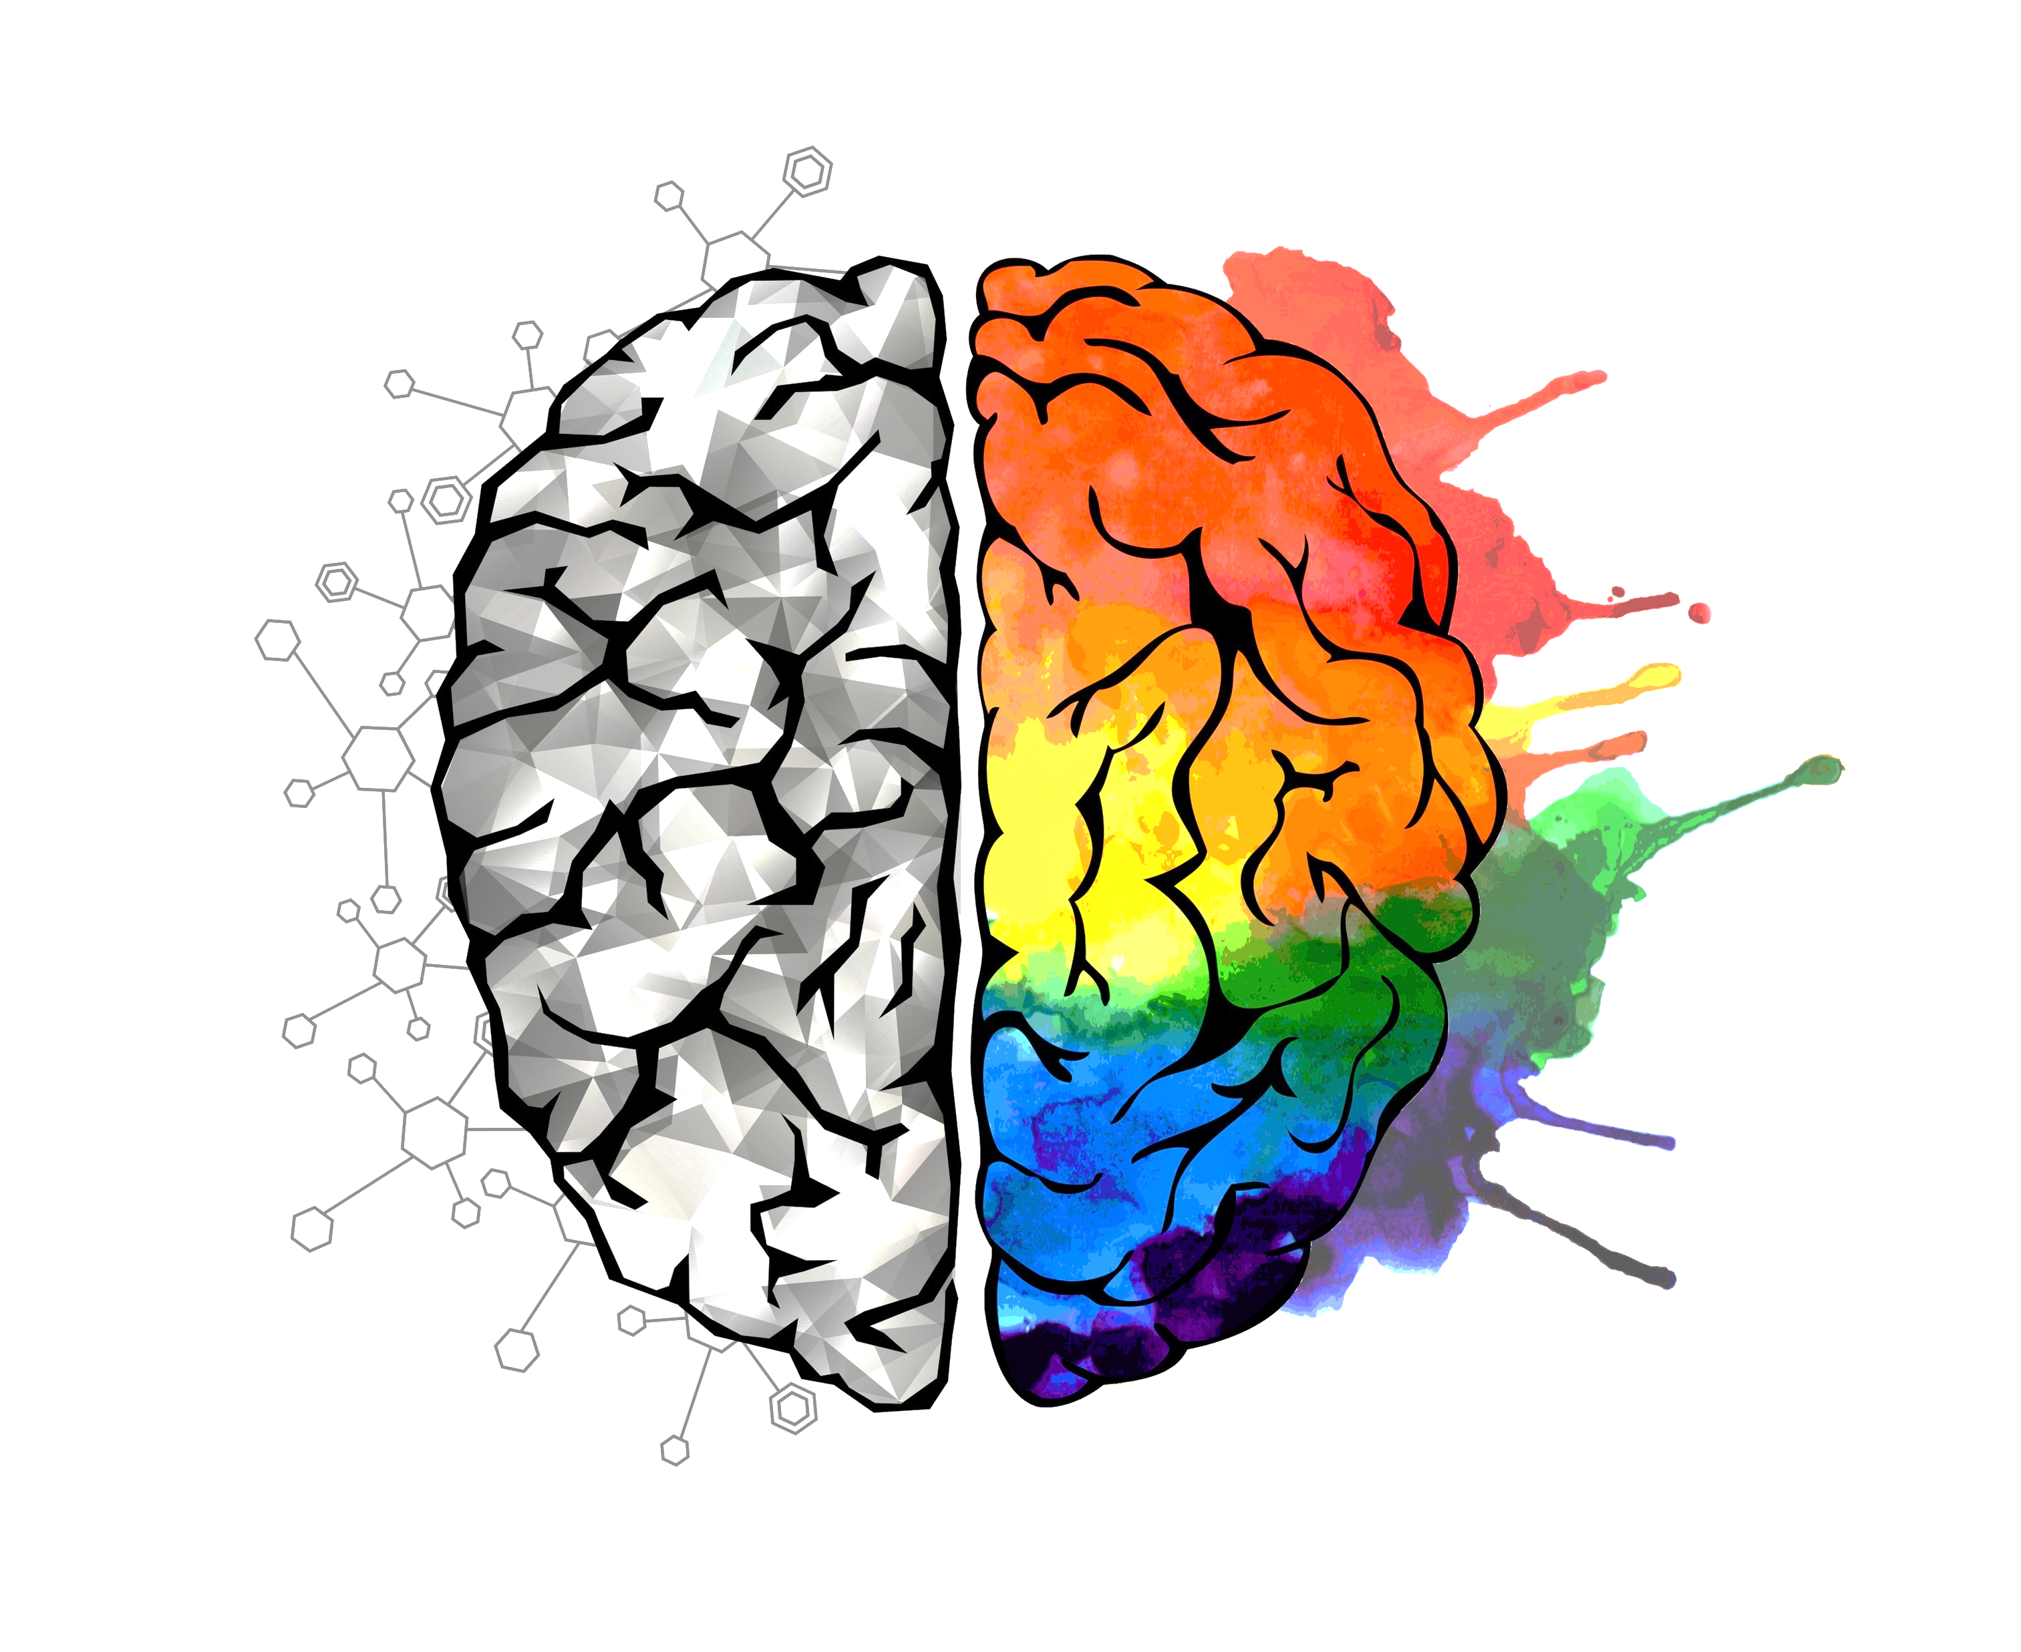
Agenda
Generative AI: innovation opportunities
AI Evolution: from Assistants to Agents
Demo: EU Regulation Analyst
Notes:
Add the bedrock console offer

Slide 5




Marcel Castro
Sr. Data Scientist & AI
Ph.D. in Computer Science, KAU/Sweden.
Experience:
network engineer, data scientist, cloud architect
AWS Generative AI Ambassador
Hobby: automation and robotics.
Marcel.castro@km.kongsberg.com
marcelcastrobr
marcelcastrobr

Slide 6
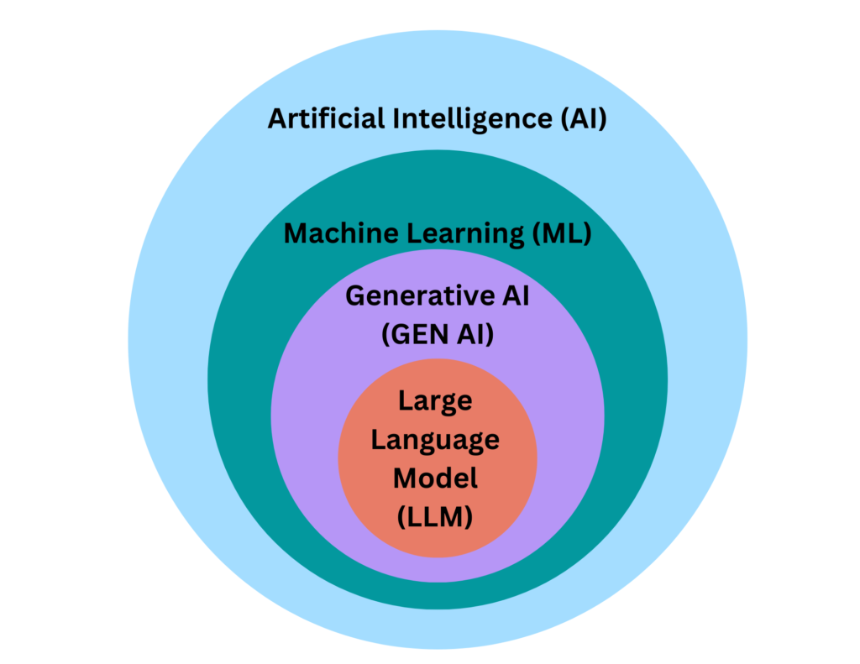
AI/ML/DL/Generative AI: Overview
Today’s discussion
Source: Picture

Slide 7





<Slide: Democratizing GenAI>
Innovation can transform industries
GENERATIVE AI
Notes:
Generative AI has taken the world by storm because we’ve been able to–through consumer-facing applications like ChatGPT—experience how powerful the latest machine learning models have become.
While a lot of attention has been given to how consumers are using generative AI, we think there is an even bigger opportunity in how businesses will use it to deliver amazing experiences for their customers and employees.
The true power of generative AI goes beyond a search engine or a chat bot. It will transform every aspect of how companies and organizations operate.
The potential of Generative AI is incredibly exciting with Goldman Sachs forecasting a $7T increase in global GDP and lift productivity growth by 1.5 percentage points over a 10-year period.

Slide 8
Enhance Customer Experiences
Boost employee productivity
& creativity
Optimize business processes
Notes:
Generative AI use cases can be grouped in these 3 categories depending on who will be positively impacted.
Your customers: by using generative AI to reinvent the way they interact with your company and enhancing their experience
Your employees: by using generative AI to boost their productivity and creativity
Your backend processes: by using generative AI to optimize and augment them resulting in higher efficiencies and lower costs
Transition: Let’ have a look at some of the use cases in each of these categories

Slide 9
Enhance Customer Experiences
Boost employee productivity
& creativity
Optimize business processes
CHATBOTS VIRTUAL ASSISTANTS CONVERSATION ANALYTICS PERSONALIZATION
CONVERSATIONAL SEARCH SUMMARIZATION
CONTENT CREATION
CODE GENERATION DATA TO INSIGHTS
DOCUMENT PROCESSING DATA AUGMENTATION CYBERSECURITY PROCESS OPTIMIZATION
Notes:
Generative AI use cases can be grouped in these 3 categories depending on who will be positively impacted.
Your customers: by using generative AI to reinvent the way they interact with your company and enhancing their experience
Your employees: by using generative AI to boost their productivity and creativity
Your backend processes: by using generative AI to optimize and augment them resulting in higher efficiencies and lower costs
Transition: Let’ have a look at some of the use cases in each of these categories

Slide 10
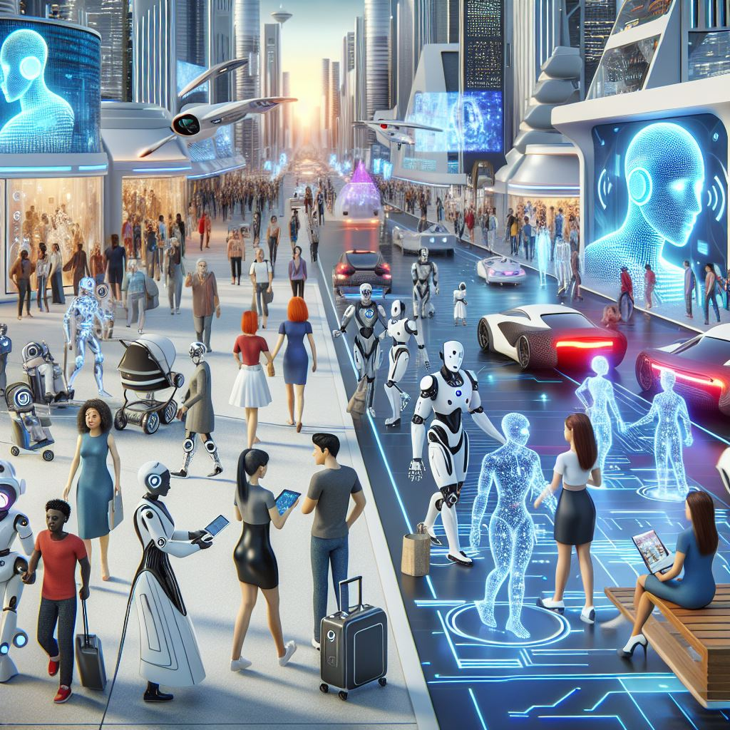
AI Evolution: from Assistants to Agents
10

Slide 11
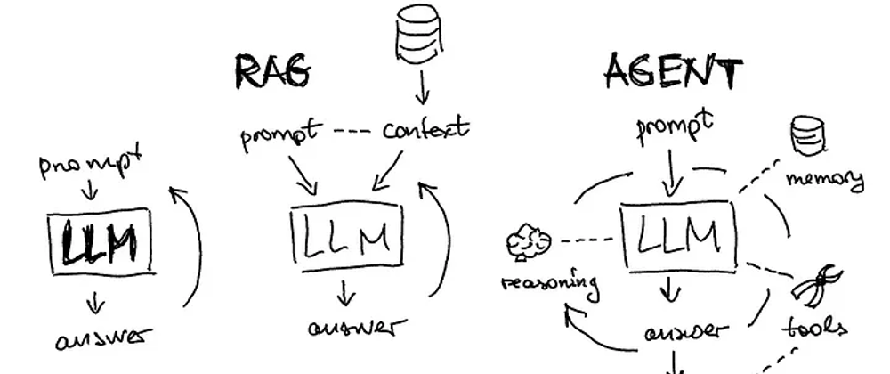
AI Evolution: from Assistants to Agents
Picture by Mhammed Talhaouy

Slide 12
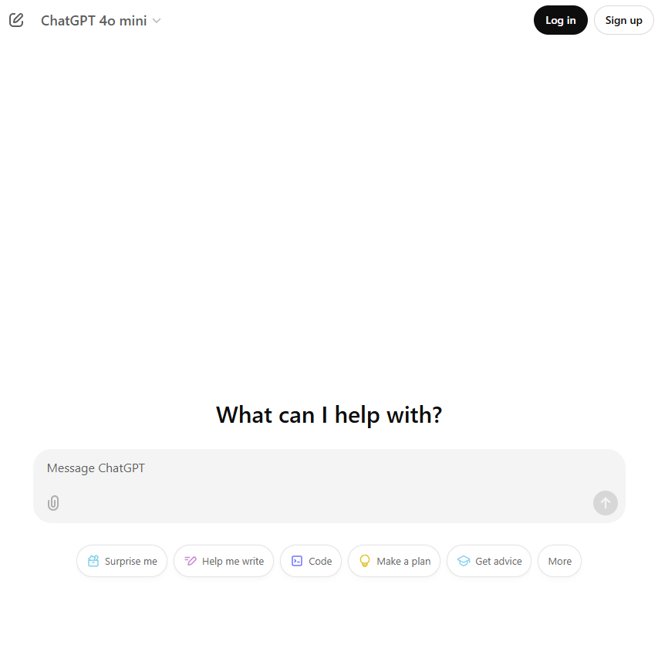
AI Evolution: from Assistants to Agents
Picture by Mhammed Talhaouy

Slide 13
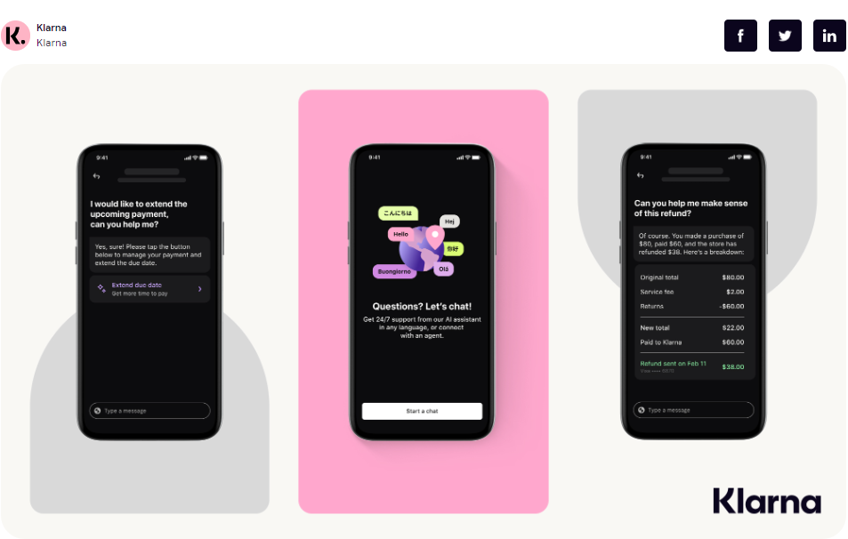
AI Evolution: from Assistants to Agents
Picture by Mhammed Talhaouy

Slide 14
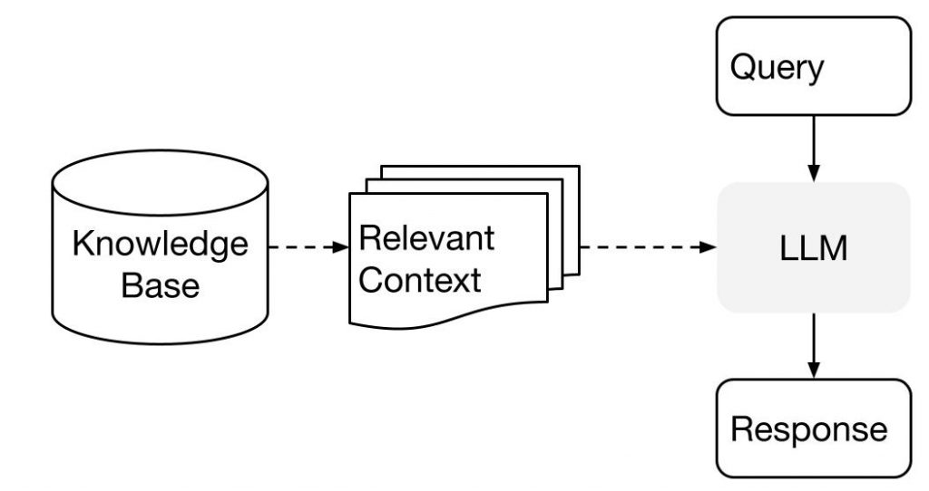
Retrieval-Augmented Generation (RAG) – High-level
Why RAG?
Overcome knowledge cut-off
Enhanced Contextual Understanding
Domain Adaptability
Improved Factuality (Less Hallucinations)
https://arxiv.org/pdf/2005.11401.pdf
Notes:
The user inputs a question.
The system searches for relevant documents that might answer the question. These documents often consist of proprietary data, and are stored in some kind of document index.
The system creates an LLM prompt that combines the user input, the related documents, and instructions for the LLM to answer the user’s question using the documents provided.
The system sends the prompt to an LLM.
The LLM returns an answer to the user’s question, grounded by the context we provided. This is the output of our system.

Slide 15
AI Evolution: from Assistants to Agents
Picture by Mhammed Talhaouy

Slide 16
AI Evolution: from Assistants to Agents
Picture by Mhammed Talhaouy

Slide 17







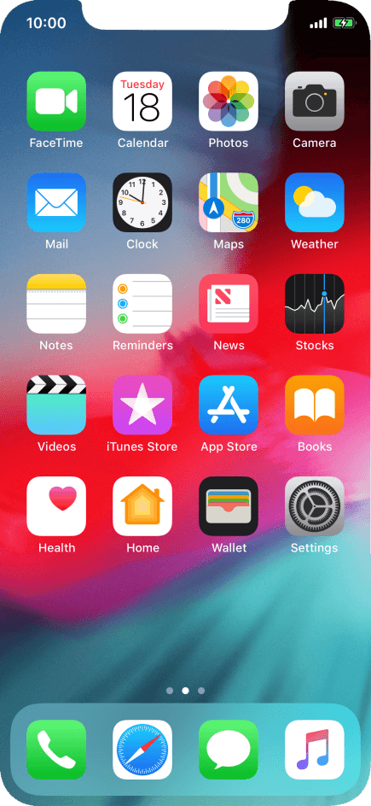

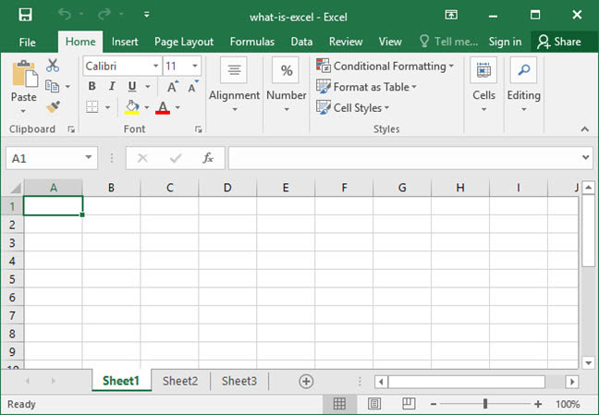
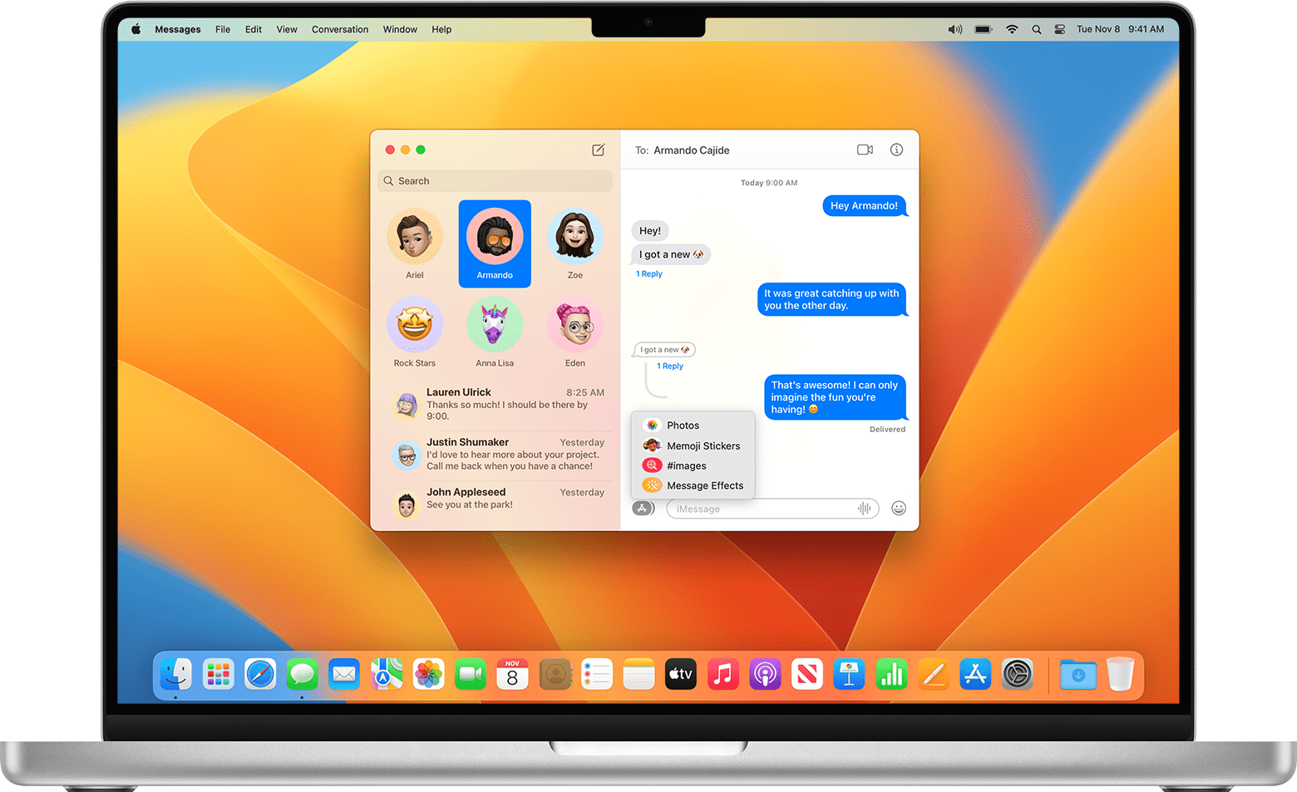
LLMs/VLMs as Agents
Actions
Environments
LLMs/VLMs
as Agents
SQL/Python code
SELECT COUNT(*) FROM table
API calls
ShopAPI({“name”: “shoes”})
Web/App controls
CLICK_COORDS(100, 100)
Robotic controls
grasp(speed=1, force=5.0)
Instruction
Data
Webs/Apps
Mobile/Desktop
Physical world
…
Response
Users
Tool using
Observation
Toolkit
Source: Tao Yu@OSWorld
Notes:
You provide a goal and
LLM has access to a set of tools
E.g. weather API
E.g. Google API
E.g. calculator
LLM decide which tool to call and when based on the goal
Often augmented with memory and planning (sketchpad)

Slide 18
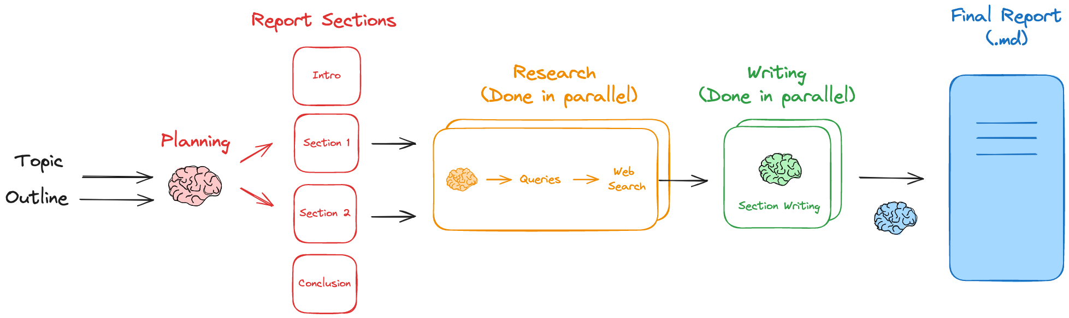
Report mAIstro: EU Regulation Analyst
Creating comprehensive reports remains a time-consuming challenge.
Source: https://github.com/langchain-ai/report-mAIstro

Slide 19
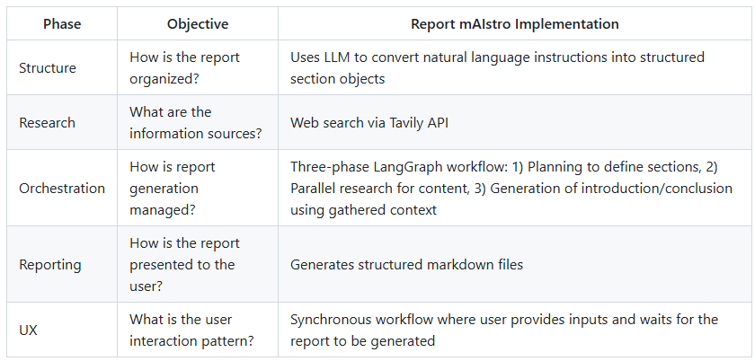



Report mAIstro: EU Regulation Analyst
Creating comprehensive reports remains a time-consuming challenge.
Source: https://github.com/langchain-ai/report-mAIstro

Slide 20
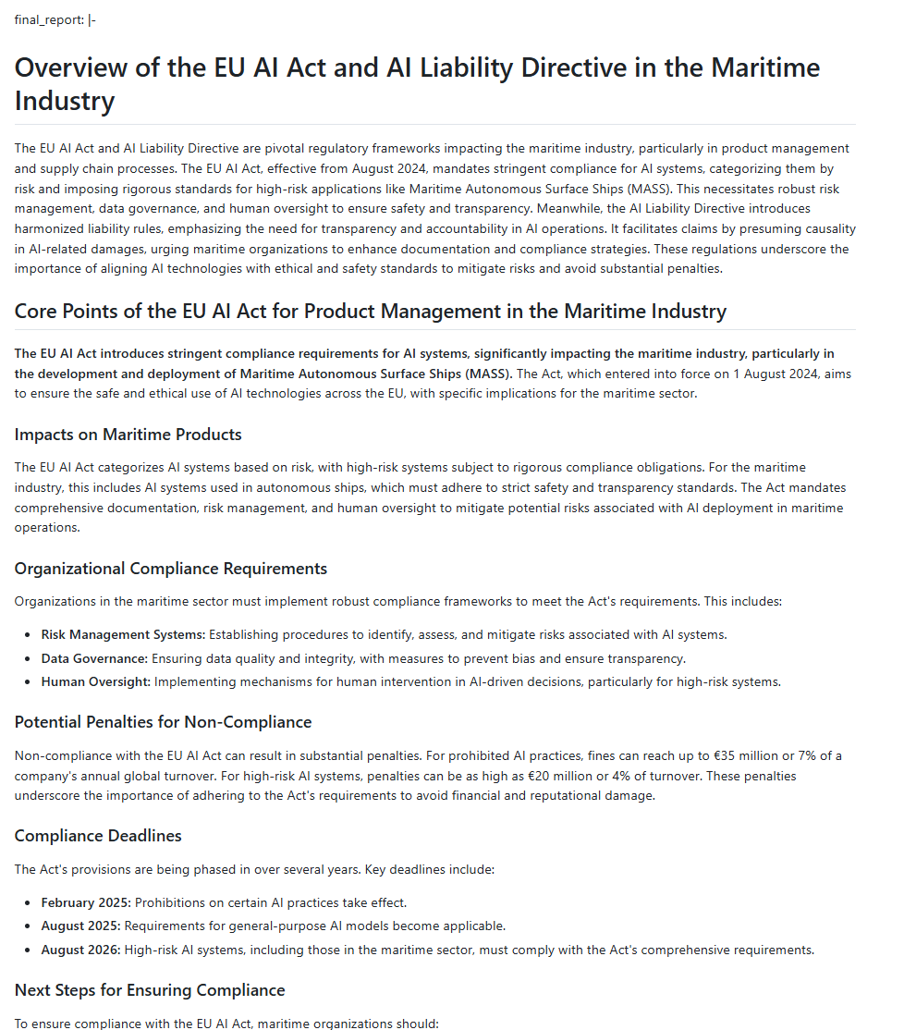
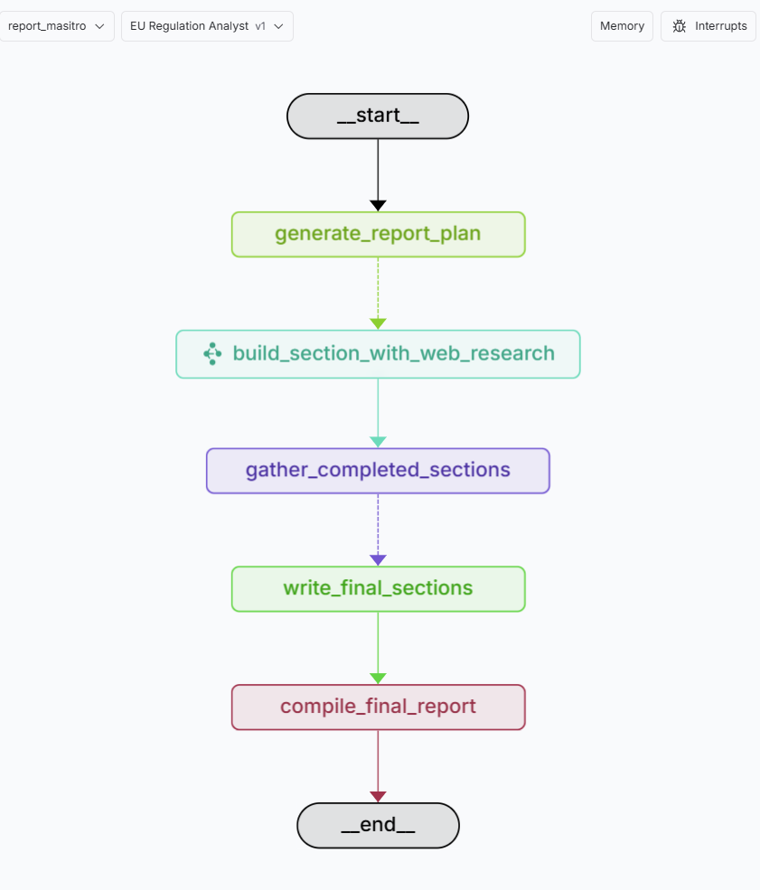
Report mAIstro: EU Regulation Analyst
Prompt: Give an overview of the EU AI act and AI Liability Directive for the following core processes: product management and supply chain.
Source: https://github.com/langchain-ai/report-mAIstro
Source: https://github.com/marcelcastrobr/report-mAIstro
Notes:
Give an overview of the Directive EU Data Act 2020/1828 and Regulation EU Data Governance Act 2018/1724 for the following core processes: product management and supply chain.

Slide 21
Recap
Generative AI: innovation opportunities
AI Evolution: from Assistants to Agents
Demo: EU Regulation Analyst
Notes:
Add the bedrock console offer

Slide 22

Thank You
https://www.linkedin.com/in/marcelcastrobr/
Marcel Castro

